Slide 1
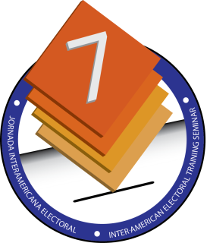
“Encouraging Citizens with Disabilities to Vote: Programs to Inform, Raise Awareness, and Disseminate Public Policies for Accessible Elections”
Sebastián Toledo, Communication Specialist on the Rights of Persons with Disabilities
September 23, 2014, Mexico City

Slide 2
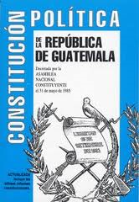
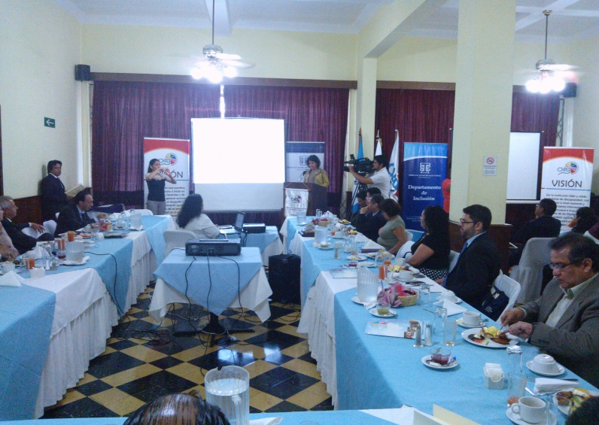
Voting by Persons with Disabilities
in Guatemala
The Constitutions of countries around the world state that all inhabitants are equal to each other. When it comes to elections and political participation, everyone has the right to elect and to be elected. This principle of equality is not applied in the same way to different segments of the population—especially to groups considered vulnerable, including people who live with disabilities.

Slide 4
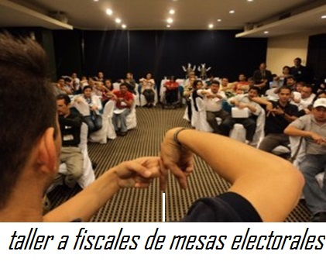
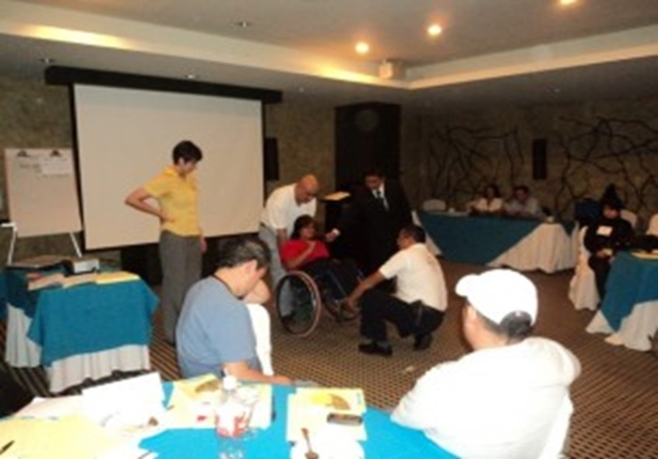
Accessible Information
on the Electoral Process
Information is provided in accessible formats: audio, Braille, large-print text, sign language, and easy-to-understand materials. This information was given to strategic groups associated with the subject, including teams of volunteers, election boards, and political party poll watchers.

Slide 5
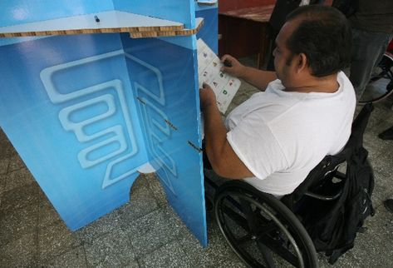
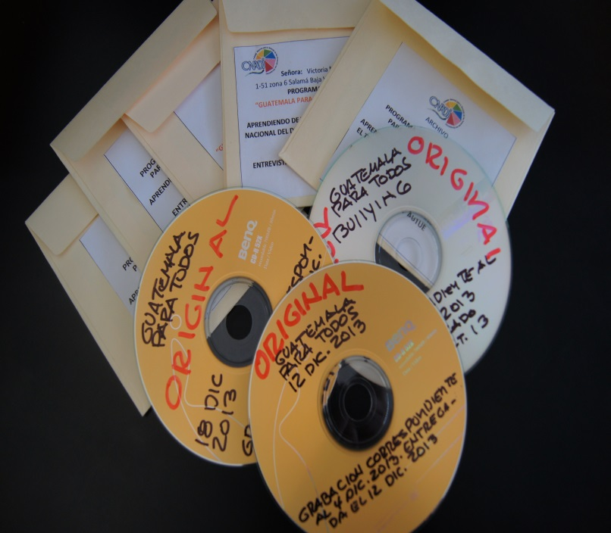
Low writing surfaces
Information in audio format

Slide 6
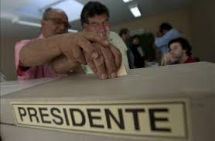
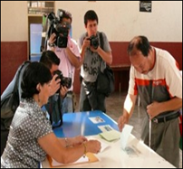
Voting Rights for Persons with Disabilities from a Public Policy Perspective
In light of Article 29 of the Convention on the Rights of Persons with Disabilities, concerning voting rights and political participation, conditions are put in place so that national movements in this sector can make suggestions to the Electoral Councils on ways to revise and update their programs and internal regulations.
Assisted Voting
Braille Ballot

Slide 7
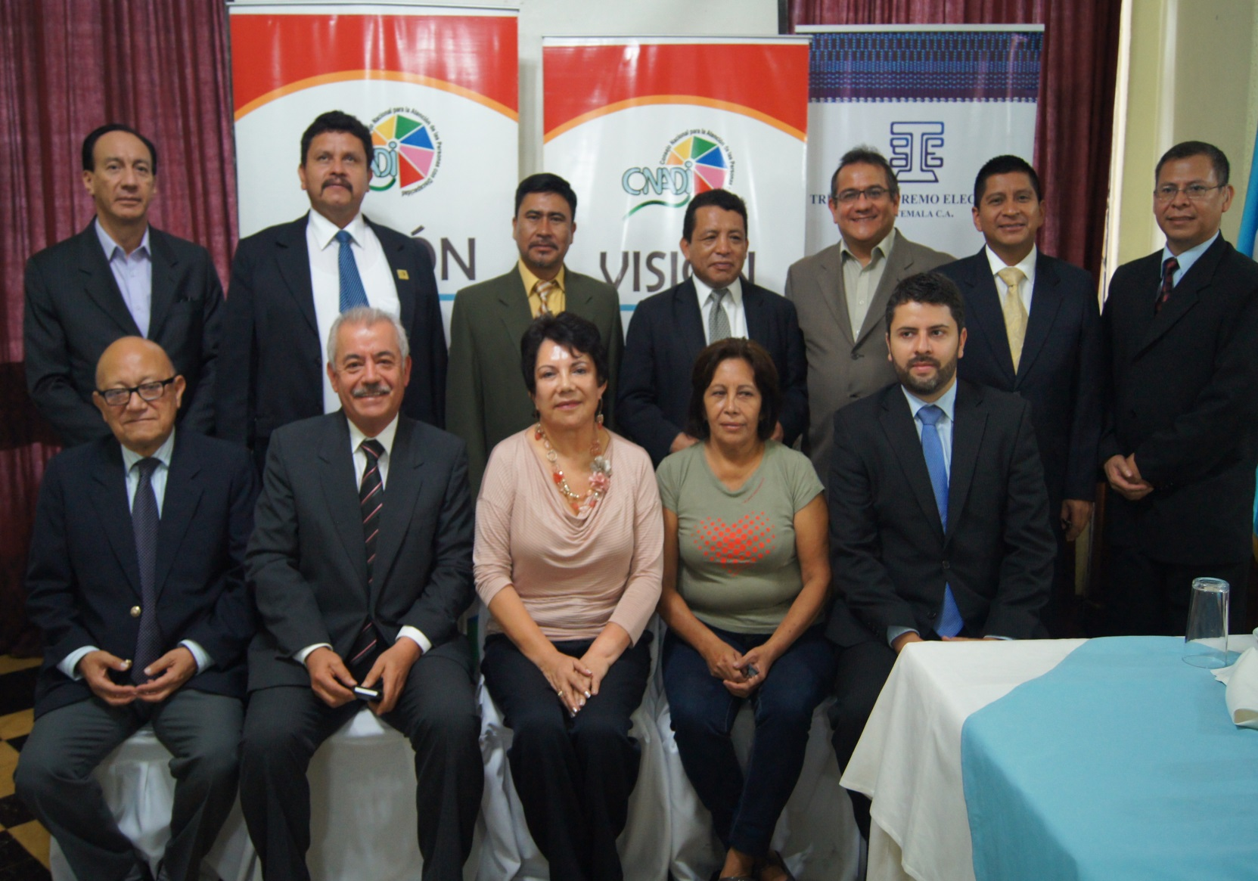
Inter-Institutional Coordination on Electoral Legislation
for Persons with Disabilities

Slide 8
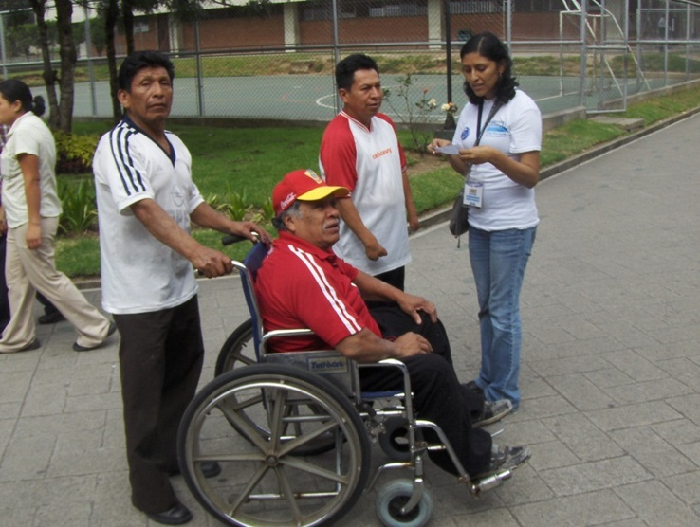
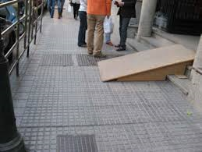
Some Thoughts on How to Encourage Voting
by Citizens with Disabilities
Latin America has made significant progress on voting and political participation by persons with disabilities; however, many challenges still must be addressed for this to become state policy. Efforts need to be made in the area of communication and information, greater awareness of voting rights, political involvement, and accessibility.

Slide 9
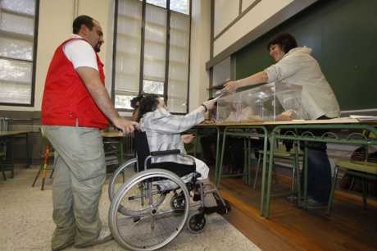
Groups of persons with disabilities should organize themselves to promote information workshops on voting rights and the mechanics of participating in elections, and to encourage simulations.

Slide 10
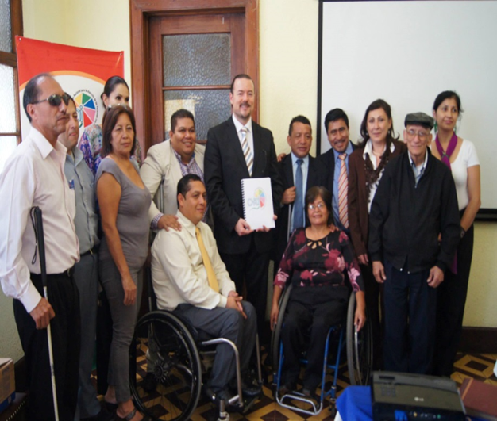
“As persons with disabilities, we exercise our vote to secure the right to elect and to be elected, because we want to demand that political promises are kept and we don’t want others to make decisions for us about who should govern us.”

